Slide 1

“‘belonging’,belongingness, ‘university belonging’, ‘emotional belonging’, ‘social belonging’”
“An Action Research Approach to Compassionate Teaching.”
Rebecca Brenda Harper PgCert HE in Academic Practice, UAL
15th January 2025
Notes:
Slide 1: Introduction, to the Context of belonging:
"Belonging, as Baumeister and Leary define, is the sense of mattering and interpersonal connectedness—a basic human need that drives motivation and behaviour. In my teaching practice I wanted to hone an area where pastoral care and creative practice intertwine, vital in arts education, where collaboration and personal expression are central. Yet Belonging remains challenging to cultivate in a way that feels both meaningful and measurable.
As belonging is the next step on the equity, diversity, and inclusion ladder. Joanna West asks, ‘Does everyone feel valued, connected, and able to be their authentic self?’ For underrepresented students, this sense of inclusion is critical in addressing systemic inequities.
Not just a buzzword - Research shows its directly linked to enhancing resilience, mental health, student success, motivation and retention. Equally is the importance of meaningful staff-student interaction and developing learners' identities in Impacting confidence and artistic identity.
My question began: how can we as educators actively shape spaces that not only welcome but empower all students to flourish in a way that is meaningful and tangible?

Slide 2
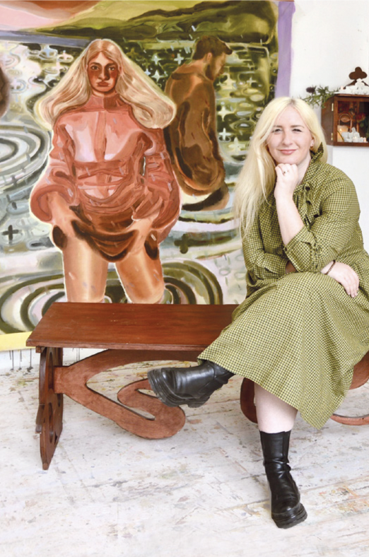
About Me:
* Rebecca Harper
* Born and living in London
Education:
Varied experience of Comprehensive and Private School
BA Hons Fine Art UWE
Royal Drawing School Postgraduate
Turps Art School Postgraduate
Fine Art Practice:
Painter
* Teaching Practice:
Fine Art Painting at UAL’s Foundation in Art and Design
BA Drawing into Print UWE
Painting at Turps Art School
Drawing at RDS
“My Arts and teaching practices are both deeply influenced by my mixed-heritage Jewish background.”
“I believe that our personal expression shapes our work and gives meaning to what we choose to make. The psychological sense that one belongs connected to their work, in a classroom and a school community, is considered a necessary antecedent to the successful learning experience."
Notes:
Slide 2: A Bit of Background about me
I teach Fine Art Painting at UAL’s FAD. In both my Painting practice and my teaching roles, I pay attention to how personal expression—shapes our creativity and artistic processes giving value and meaning to what we create but also to our sense of belonging within creative community’s. That understanding, underpins my Action Research Project - where I seek to explore students stories and visually creative voices empowering them to thrive.

Slide 3
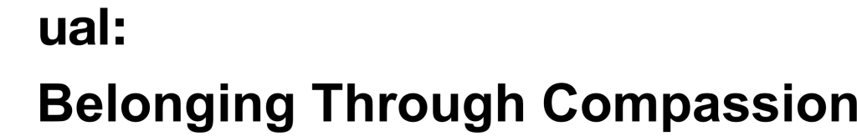
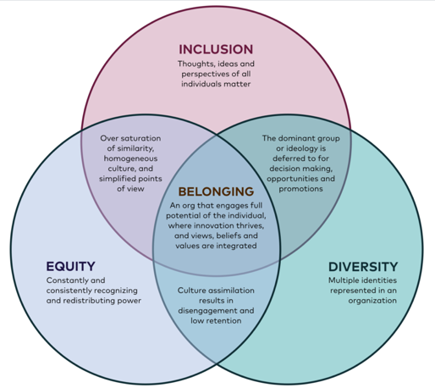
  UAL:
    Less hours
    Larger classes
    No permanent Studio Space
    Tutorials Online
    Less Contact time with Students
    Fewer staff
“UAL is a community of 5000 staff, 25,000 students and 250,000 alumni: our collective creative endeavor can and must make the world a better place. From imagination to practical innovations: creativity is the driving force behind the change we need to improve the long-term wellbeing of all people and the planet.”
Social Justice: “In our work towards social justice, we acknowledge structural oppression and aim to reduce its impact on staff and students in higher education. Key principles of belonging through the praxis of compassion are offered here. We define key terms and myth-bust some common misconceptions. We make the case for why compassion and belonging should be central to our practices and policies in higher education.”
Teaching: “We advocate slowing down and making space to share our humanity and emotional connectedness with and between students in our teaching. Rather than trying to do more, we can try to do things differently. Fostering belonging isn’t about providing extra support or additional interventions. As Prof. Terrell Strayhorn highlights, what is needed is a focus on how our interactions and teaching approaches can help students feel that they matter. We view this as an embodied practice where we enact personally meaningful expressions of care, community and connection.”
“UAL nurtures and shares the creativity the world needs to: Build equitable prosperity and wellbeing for all people.”
Relationships: ‘Belonging is social and relational built on human and nonhuman connection. We explore principles of trust, care, respect and self-compassion in developing nurturing educational relationships.’
Notes:
UAL Research Context
UAL, as a social purpose university, of —25,000 students—is dedicated to nurturing wellbeing and building inclusive societies.
However, translating these ideals into daily student experiences is complex, take the latest Foundation merger - prompting significant shifts in structure’s and environments. Tutorials now online, serve as students’ first meaningful connection with a tutor, where students may feel adrift. “Belonging” Through Compassion at UAL has become a crucial concept, yet do we share a clear understanding of what it really means? And what our role is in nurturing it?
UAL’s strategy encourages that rather than doing more, just do things differently, there’s tensions between institutional aspirations and meaningful enactment on the ground. I looked at bridging this gap, exploring how we can nurture belonging and inclusion within the curriculum’s tutorials, ensuring UAL’s aspirations become lived realities for every learner,

Slide 4


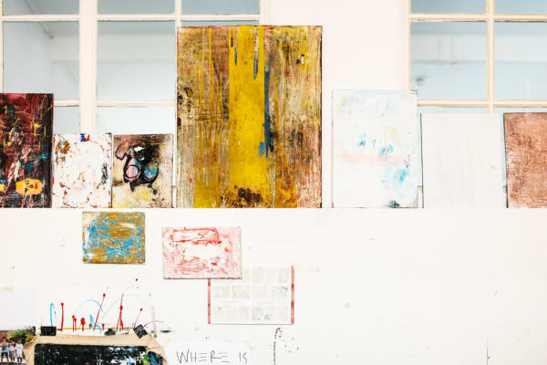

z
Research Question: How Can the Tutorials be structured to Foster a Sense of Belonging in Foundation Art and Design? Particularly within the first pastoral/academic tutorials?
“Pastoral/Academic tutorials are a critical touchpoint for new students facing uncertainty in their academic and personal journeys.”
Notes:
Research Question:
Given the challenges—my question became: How can the Tutorials be structured to foster a sense of belonging and inclusion? Particularly within the initial pastoral/academic tutorials? Inquiry’s focused on creating inclusive spaces for students adjusting into new academic and social contexts.
To achieve this, I incorporated visual participatory methods, offering students creative and reflective ways to express their feelings about the course, their artistic identity and course challenges. These activities supported students artistically, academically and pastorally, providing a safe space to share experiences and establish their place within the learning community from the outset.

Slide 5
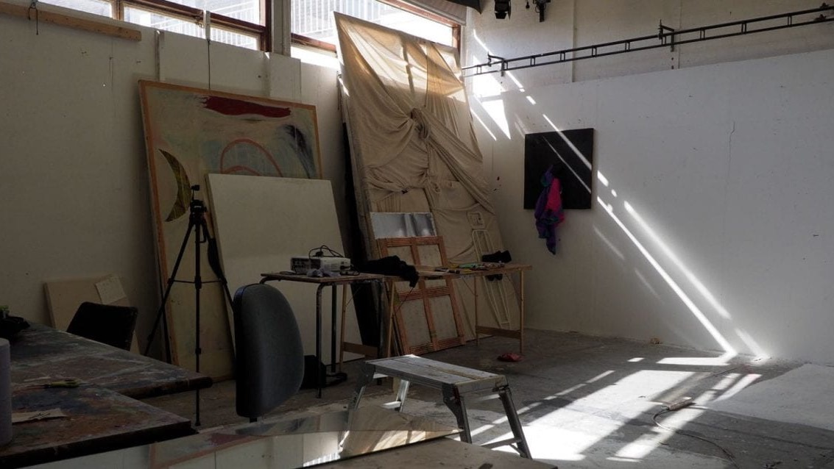
“Students' sense of belonging was found to be positively related to emotional wellbeing, academic motivation, and success in HE” (Chun et al., 2016; Pittman & Richmond, 2008; Thomas, 2012; van der Zanden et al., 2018; Won et al., 2018; Zumbrunn et al., 2014).
“Sense of belonging is a fundamental human need” (Baumeister & Leary, 1995)
“the experience of personal involvement in a system or environment so that persons feel themselves to be an integral part of that system or environment” (Hagerty et al., 1992, p. 173).
“According to Strayhorn (2019), the need for sense of belonging takes on heightened importance in (a) contexts someone experiences as foreign, unknown, or dissimilar, (b) developmental phases that are challenging or where an individual is extra vulnerable, such as (late) adolescence, and (c) contexts in which specific individuals are prone to feel marginalized or unwelcomed” (Anderman & Freeman, 2004; Maslow, 1962; Strayhorn, 2019)
Notes:
Research Rationale: Significance of belonging for creativity and success in HE.
In creative disciplines, students take vulnerable, creative intellectual and emotional risks, so fostering belonging early is critical. Tutorials—spaces of connection and reflection, empathy and co-curation—are uniquely positioned to address this need. Where learners feel valued and included, they’re more likely to engage, and thrive.
Belonging is relational, defined by Hagerty as personal involvement in an environment so individuals feel integral to the system. Strayhorn establishes the heightened importance for students finding themselves in unfamiliar or vulnerable contexts—navigating new academic or cultural contexts.

Slide 6
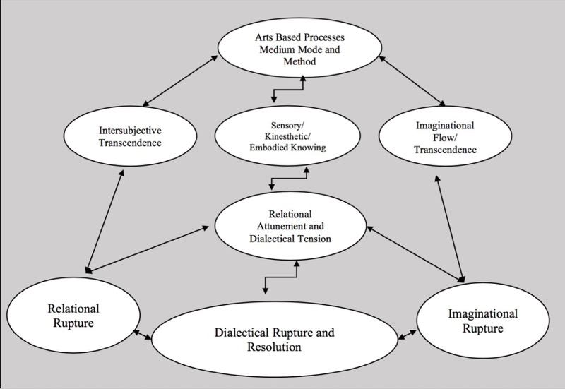
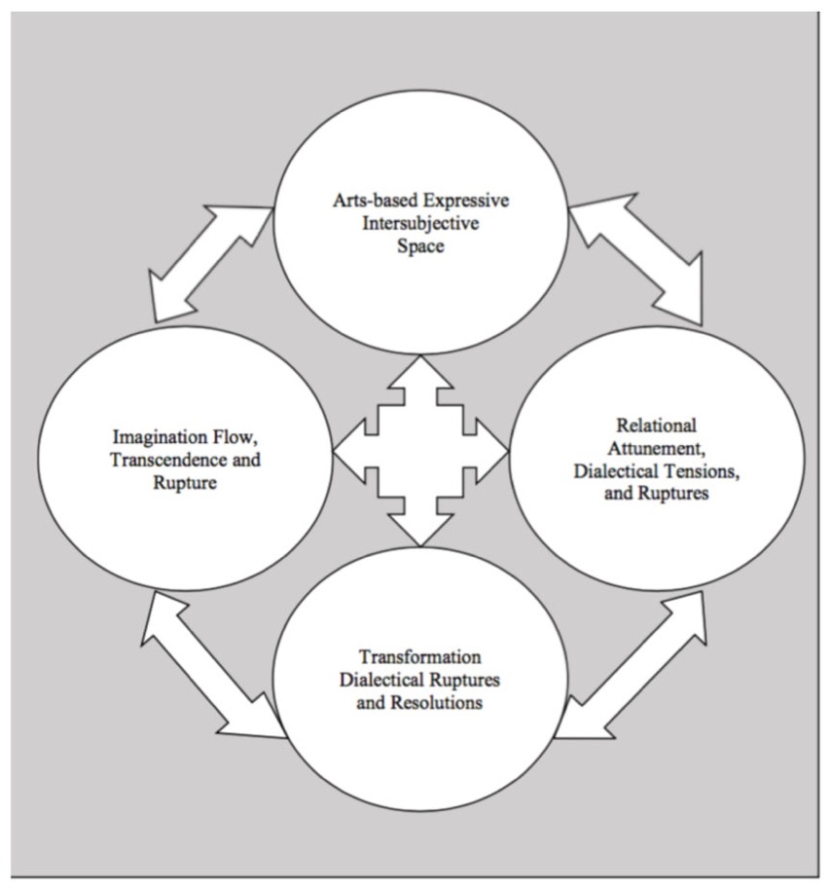
ABAR FRAMEWORKS
“Art-based action research creates a space where participants can express tacit knowledge—those insights and emotions difficult to verbalize—through artistic means. This participatory approach enables individuals to engage deeply with social issues and personal experiences, fostering both individual and community development.” Jokela and Huhmarniemi (2008)
Notes:
Frontiers in Psychology (2018)
FIGURE 1. Kinetic mobile system for dynamic change.
FIGURE 2. Orbital system for dynamic change.
Research Rationale: Significance of belonging for creativity and success in HE.
In creative disciplines, students take vulnerable, creative intellectual and emotional risks, so fostering belonging early is critical. Tutorials—spaces of connection and reflection, empathy and co-curation—are uniquely positioned to address this need. Where learners feel valued and included, they’re more likely to engage, and thrive.
Belonging is relational, defined by Hagerty as personal involvement in an environment so individuals feel integral to the system. Strayhorn establishes the heightened importance for students finding themselves in unfamiliar or vulnerable contexts—navigating new academic or cultural contexts.

Slide 7
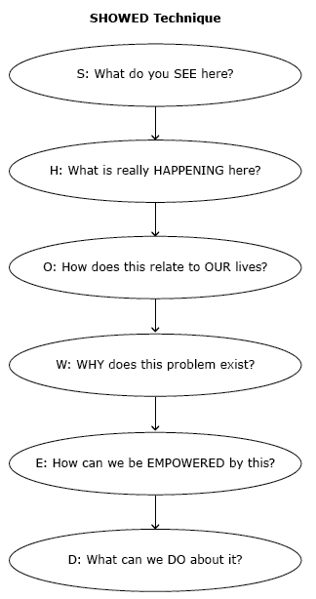
METHOD 1: PHOTOVOICE
“A method including taking but also explaining photos, which is termed photovoice’ (Wang & Burris, 1997).”
“What distinguishes photovoice is that it empowers participants by giving them the option to take photos and choose photos for further analysis giving them agency and voice over what is discussed, portrayed, and how (Wass et al., 2020).”
“The photovoice method facilitates access, knowledge, and assessment of group needs from their own perspective (Wang & Burris, 1997), while promoting processes of sharing, inclusion, and empowerment (Wang & Burris, 1994).”
Notes:
Photovoice: Chart showing the Photovoice process (taking photos → sharing → discussing → analysing).
Art-Based Action Research (ABAR) Framework
I adopted Art-Based Action Research, (in short ABAR), frameworks, engaging reflection, dialogue, and inclusion through artistic expression. Creating a triadic relationship between the learner, tutor, and artwork, allow meaning to emerge organically.
I used reflective prompt questions and integrated embodied, tacit, and sensory knowledge, what Bollas described as revealing primal, unconscious forms of cognition.
Inspired by models depicting learning as an interconnected system—much like a kinetic mobile. This metaphor highlights how elements like environment, stakeholders, and personal experiences interact fluidly shaping learning journeys. Promoting explorations of identity and experience authentically, supporting diverse voices and self-efficacy to those who may feel disconnected or excluded in traditional settings.

Slide 8
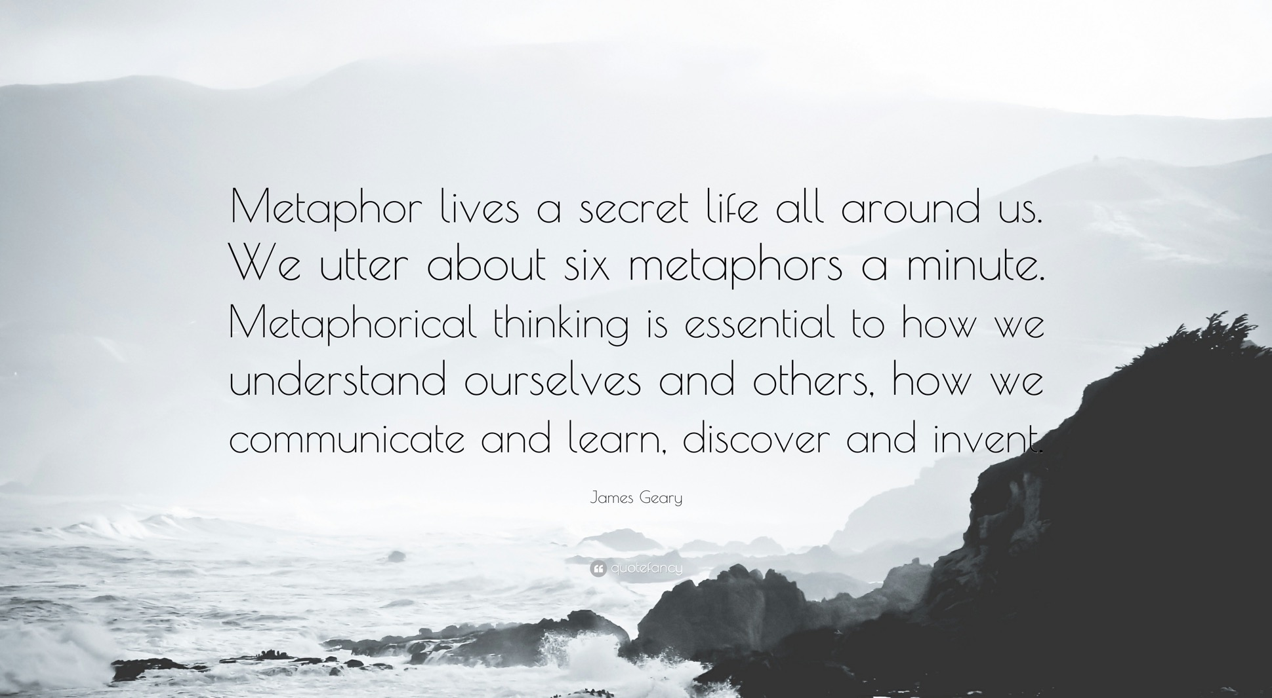
METHOD 2: METAPHORICAL SELF PORTRAIT
“Visual research methodologies has disproportionately favoured digitalised developments in photographic and video tools over, what now seems to be, the old ‘tradition’ of drawing. (Wang 2007) Where photovoice and digital storytelling have ushered a new ‘way of thinking’ – a reconceptualization – and practical ‘know how’ among qualitative practitioners working with children and young people."
“This practice thus has the transformational potential to facilitate and/or reinforce one’s internal locus of control, that is the degree to which someone psychologically attributes (and feels like they have) control, management, self-governance and authorship over the narration of their lived-realities. As opposed to, an external locus of control where attribution is located within external considerations, beyond the hands and control of the individual self (Bandura 2001).”
“The practice of drawing, in a participatory context, empowers and psychologically nourishes the child and-adult-drawer with self-efficacy.”
Notes:
ABAR METHOD 1 planning and interventions
The first method I used was Photovoice, involving students taking and selecting one photograph representing their feelings about the course or practice. On teams students shared their chosen image, which became a starting point for explaining through the photo, enabling reflection, discussion and analysis.
This method empowers students by giving them control over what they share, thus what is portrayed and analysed, shaping focus of the discussion. It also encourages expressions that may not easily convey in words.

Slide 9
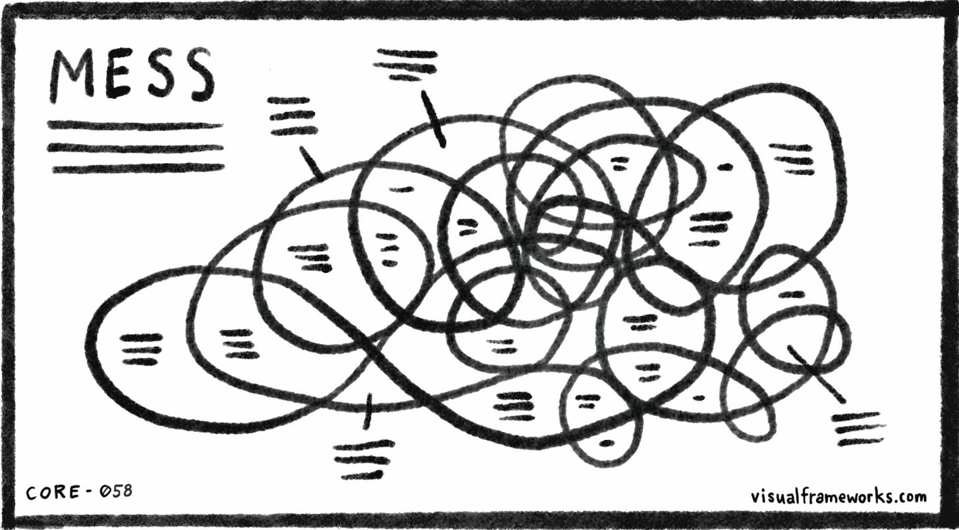
Notes:
Dave Grey (Visual Frameworks for Stuckness)
ABAR METHOD 3 Planning and Interventions
"The third was the ‘Stuckness’ method, a two-minute drawing reflecting where they felt stuck.
Introduced later on in the tutorial, It encouraged students to unpack challenges helping to visualize and articulate challenges— like creative blocks, logistical hurdles, or cultural disconnection.
By externalizing barriers to ‘stuckness, the activity addressed agency and created space for collaborative problem-solving, creating space for solutions and steps toward progress."

Slide 10
Ethical Framework
Consent
Clear explanation of project purpose, methods, and data usage.
Informed consent obtained prior to focus group tutorial meetings.
Stress confidentiality and anonymity.
Respect participants' right to withdraw at any time.
Confidentiality
Ensure participants' data is anonymized (e.g., crop or blur faces in images).
Share findings without identifying individual students.
Maintain secure storage for visual and written data.
Minimizing Bias
Co-created guidelines with students to ensure empathy and respect during tutorials.
Reflect on the researcher’s inherent bias in observing and interpreting data.
Phrase questions carefully to avoid leading responses or influencing outcomes.
Acknowledge limitations in the research sample or methods.
Barriers to Engagement
Recognize potential obstacles like time constraints or language proficiency.
Provide additional time and clear instructions for students with accessibility needs.
Identify and address curriculum timetabling limitations.
Notes:
I have grouped the breakdown into ethical categories
Slide 9: Ethics:
Consent
Clear explanation of project purpose, methods, and data usage.
Informed consent obtained prior to focus group tutorial meetings.
Stress confidentiality and anonymity.
Respect participants' right to withdraw at any time.
Confidentiality
Ensure participants' data is anonymized (e.g., crop or blur faces in images).
Share findings without identifying individual students.
Maintain secure storage for visual and written data.
Minimizing Bias
Co-created guidelines with students to ensure empathy and respect during tutorials.
Reflect on the researcher’s inherent bias in observing and interpreting data.
Phrase questions carefully to avoid leading responses or influencing outcomes.
Acknowledge limitations in the research sample or methods.
Barriers to Engagement
Recognize potential obstacles like time constraints or language proficiency.
Provide additional time and clear instructions for students with accessibility needs.
Identify and address curriculum timetabling limitations.
I grouped the ethical framework into categories; Consent, Confidentiality, Minimizing Bias, Barriers to Engagement. Obtaining informed consent via email and ensuring students understood the purpose, methods, and anonymization of their data. Confidentiality and the right to withdraw were emphasized to create a comfortable environment. To reduce bias in observational data, I reflected on my dual role as tutor and researcher, co-created empathetic, respectful, non-judgment guidelines with students, and designed neutral questions. This socially responsible approach prioritized consent, anonymity, and a student-centred ethos.

Slide 11
Student 3: Image: A self-portrait in class, smiling, wearing funny glasses.
Student 2: Image: Dark landscape with butterflies.
Student 1: Image: A sculpture made by the student symbolizing an inaccurate X-ray image of a bone.
Notes:
Photovoice Findings
The Photovoice data findings included eight students’ images and their verbal reflections, there were multiple groupings, bur some of those key themes: Aspirations, Artistic Identity, and connection.
Student 1 shared a sculpture of an x-ray bone, symbolizing adaptability and growth through challenges. (blue representative of emotional struggle). Their reflection about being happy despite those challenges highlighted their resilience and connection between personal growth and their academic journey. This image reflected that balancing of personal difficulties with their artistic development suggesting that despite feeling stuck there was a deep sense of perseverance and hope.
Student 2 presented monochrome butterflies, symbolizing their feelings of confusion and excitement. Reflecting the tension between confusion and ambition, connecting emotions such as feeling both overwhelmed and motivated by their connection to nature and the elements to professional aspirations in fashion textiles. This image beautifully captured the tension between uncertainty and ambition. Illustrating perfectly how they connected personal feelings to their professional aspirations.
Student 3’s self-portrait with funny glasses reflected on their journey from Peru, where art is not traditionally seen as a career. They expressed challenges adjusting to the course’s pace, while also embracing family support. This image and reflection revealed the intersection of cultural identity and academic aspirations, shedding light on navigating personal histories while adapting to new academic and creative environments.
Together illustrating connection’s to their creative identities, aspirations, and connection, offered insights into emotional and academic states.

Slide 12
Metaphorical self portrait drawing/ Student 8 Quote :
“This is a drawing of a floating spaceman above a sea of small alien figures. ‘In my work I usually use the spaceman figure- I did the aliens behind because there are a lot of new people I don't know. When I was young, I used to think people were aliens. I would add lots of people into quite a small space. I like space and physics; I’m interested in it. I like the space suit because it's a hidden representation, but it’s something that humanity did that was bold despite not being able to see their identity. Perusing Art is a bold thing to do, I think. It feels exciting despite people, there is a jumble of lots of things happening. After a week of me starting the course, my mum got diagnosed with cancer, so starting something new with mum too is challenging.”
Observational Note: This student was both quietly reserved and a willing active participant. The emotional tone was one of calm, hope and thoughtfulness.
“Barriers to Belonging: Disconnection and Growth.”
Student 8: Floating Figure Over a Landscape of Aliens
Student 6: Gestural graphite Face
Student 5: Self-portrait with Green and Pink Explosions
Student 7: Drawing of a Bucket
Notes:
Metaphorical portrait findings
The metaphorical self-portrait data findings included eight students’ images and their verbal reflections, there were multiple groupings, but revealed themes such as disconnection and adjustment.
Student 7 s drawing of a bucket, symbolized feeling ‘half full’—representing their process of adjusting to the course’s fast pace and unfamiliar structure. Saying : 'Moodle and Workflow have been difficult, but I’m gaining confidence.' This illustrates how some students are still adapting to academic systems.
Student 6, gestural graphite face emphasized an exciting energetic artistic process. sharing: 'I like making quick, spontaneous art, but structured assignments feel stressful. This exposed the tension between enjoyment and stress from more structured, time-consuming projects.
Student 5’s green and pink explosions captured homesickness and adaptation: They shared: 'I’m in two places at once—enjoying freedom here but missing home.' This captures the cultural transition they face in adjusting to the course.
Finally, Student 8’s spaceman drawing expressed disconnection but boldness: They reflected: 'Pursuing art is bold and exciting but challenging.' Indicating how students are navigating feelings of isolation while embracing the excitement of self-expression.
These reflections demonstrated the complexity of adapting to the course, in both struggles and growth.

Slide 13
‘Stuckness’ Methods: Addressing Barriers Through Reflection and Expression"
Student 4 drawing: Cropped Image: a zoomed in version of a USB stick and big hand.
Tech and narrative are key. This is cyber reality, cyber awareness in the future- I wanted to push that in my sketchbook and that concept on the body. I’ve been inspired by cyber punk video games and bringing more realism and reality into it. It could all be worse for reality. I don't feel completely blocked- materials and sculptures and crafting 3D models (in cardboard and card) has been good, because it can bring more creativity quickly. Card and paper though I use a lot and it also means that I am running out of ideas. I should look for more materials in skips etc that is not card and paper- It’s on me to be organized to do that. I need to be more prepared with my materials.
Observational Note:
This student was both motivated and open, an active participant. The emotional tone was one of curiosity, stimulation, regulation and awareness.
Notes:
Method 3- "Stuckness Methods: Addressing Barriers Through Reflection and Expression"
The Stuckness Drawing data provided valuable insights into students' creative and emotional blocks through six analysed drawings and verbal reflections. Themes of personal and academic challenges and artistic struggles came up.
Student 4 illustrated a USB stick, symbolizing engagement with tech, cyber themes and creative block, sharing: “I need to explore new materials; I’m running out of ideas but trying to push myself with new ones.” This highlighted their awareness of limitations and desire to grow with personal challenges. Reflecting a strong desire to overcome barriers despite exhaustion, burnout, and time constraints.
Similarly, Student 6 reflected on how personal setbacks, like visa delays, disrupted their creative process.
These opened understanding of how personal and academic challenges intertwine with artistic struggles.

Slide 14
Method Reflections Across Questionnaire
Insights from Photovoice and ‘Stuckness’ Methods
Notes:
Method Reflections Across Questionnaire
Across all methods—students provided valuable qualitative insights into their emotional states and sense of community.
While the quantitative survey data only collected 3 respondents feedback across the tutorials, a low response rate. Regardless the feedback was valuable—both photovoice and stuckness methods were rated highly effective in fostering support and inclusion, with 100% of respondents feeling supported, indicating the effectiveness of these methods in supporting students' emotional and artistic growth.
It also highlighted challenges of time constraints in fostering deeper engagement, feedback was mixed, some feeling it was sufficient, while others felt more artistic discussion was needed. Suggesting possibly the students who didn't do advance preparations or the activity introduced later on may have felt disconnected or rushed. Revealing both their sense of belonging and the obstacles they face that can impede it.
Method Reflections Across Questionnaire
Subtitle: Insights from Photovoice and Stuckness Methods
1. Overview of Survey Feedback
Surveys Conducted:
Survey 1: Photovoice Tutorial
Survey 3: Stuckness Drawing Tutorial
Response Rate:
Total responses: 3
Low response rate led to additional reliance on observational data.
2. Common Findings Across Surveys
Support and Inclusion:
100% of respondents rated the tutorials as “Very effective” in fostering support and a sense of inclusion.
Quote from Survey 1: “The tutorial helped me feel supported and gave me space to speak about my time at UAL.”
Time Allocation:
Mixed responses for time to discuss artistic practice in Survey 1:
50%: “Yes, sufficient time.”
50%: “Somewhat sufficient.”
Survey 3: The single respondent felt exercises had sufficient time (100%).
Suggestion: Allocate more time or structure for in-depth discussions about artistic practice.
Quality of Tutorials:
Rated “Excellent” across both surveys, reflecting a strong overall reception.
3. Insights from Individual Surveys
Survey 1 (Photovoice Tutorial):
Strengths:
Opportunity for personal connection was valued.
One respondent noted: “The chance to speak about my time at UAL was the most helpful aspect.”
Areas for Improvement:
Need for “a little more time” to discuss artistic practice.
Survey 3 (Stuckness Drawing Tutorial):
Strengths:
Respondent felt supported and had sufficient time for exercises.
Rated as “Very effective” in fostering a learning community.
Limitations:
Lack of additional feedback makes it challenging to extract actionable insights.
4. Comparative Analysis
Similarities:
Consent to Participate:
100% consent rate across both surveys.
Effectiveness in Support and Inclusion:
Both methods were rated “Very effective” (100%) in helping students feel supported.
Quality of Tutorials:
Rated “Excellent” by all respondents.
Differences:
Time Allocation:
Mixed responses in Survey 1 (50% “Yes,” 50% “Somewhat”).
Consensus in Survey 3 (100% sufficient).
Feedback Depth:
Survey 1 provided qualitative feedback (e.g., request for more time).
Survey 3 lacked additional comments or suggestions.
5. Actionable Insights
Strengths to Build On:
Tutorials are highly effective in fostering support and inclusion.
Positive feedback highlights the value of personal connection and creative methods.
Areas for Improvement:
Adjust tutorial timing to better accommodate discussions on artistic practice.
Explore ways to elicit more responses in future surveys (e.g., in-class surveys, incentives).
6. Visual Representation
Bar Chart:
Comparison of responses across Survey 1 and Survey 3 for “Effectiveness,” “Time Allocation,” and “Quality.”
Quotes:
Add key student quotes alongside visuals for context.
7. Closing Reflection
“While the feedback collected through surveys was limited, it provides valuable insights into the strengths and areas for improvement of the tutorials. Students valued the sense of support and inclusion but highlighted the need for more time to discuss artistic practice. Moving forward, refining time allocation and exploring strategies to increase feedback participation will enhance the tutorial experience.”
Overall Reflections Across All Methods and Questionaire
Across all three methods—Photovoice, Metaphorical Self-Portrait, and ‘Stuckness’ Drawing—students give rich, qualitative data on emotional states, preconceptions, and sense of community—or lack thereof. By foregrounding expressions of creativity, we also tapped into the essence of Art & Design education, making the inquiry process engaging and relevant for their wellbeing and practice.
There was clearly a personal depth of these activities, though there was time constraints due to embedding the methods into the circular. Ultimately, these approaches highlighted both students' sense of belonging and the obstacles that can impede it.
They allowed me to observe how students were grappling with challenges, but also finding ways to overcome them.
Reflections – Student Feedback: questionnaire I was looking at research methods from The Tools at Hand In: Survey Questions by: Jean M. Converse & Stanley Presser, 2021,
I have Incorporate one digital questionnaire on their sense of belonging before and after the tutorial series.
The challenge here was eliciting responses, however the responses I did receive offer useful insights into the effectiveness of the tutorial, specifically the use of photovoice method. Based on the data from the two respondents: The Survey responses indicate a positive reception to the tutorial's support and inclusion, with 100% of respondents feeling it helped them feel supported. However, there is clearly room to improve the time and space allocated for discussing artistic practice, with one respondent feeling the tutorial only partially met these needs.

Slide 15
Actionable next steps
Flexible Structures and Alternative Support: Introduce peer feedback groups to enhance connection, reflection, and support emotional and artistic growth within curriculum constraints.
Refine Tutorial Structures: Break tutorials into focused segments (one-on-one for creative practice, group discussions for emotional connection).
Share Findings with Faculty for Curriculum Planning: Present research insights on fostering inclusion and belonging within current curriculum constraints.
Introduce Group Discussions: Encourage peer-to-peer connections for emotional and artistic support. Offer additional resources like online guides or peer mentors for students struggling with challenges.
Increase Survey Response Rates: Use incentives or in-class feedback forms to gather more insight and actionable data.
Notes:
Concluding Thoughts and Next Steps: Actionable Steps
This action research has broadened my understanding of how to foster belonging and inclusion in tutorials. Reiterating the importance of prioritizing clarity, empathy, active participation, and emotional connection, nurturing both creative and personal growth. Yet, belonging is not a passive outcome—it requires deliberate and sustained efforts.
Moving forward with actionable steps, such as incorporating flexible structures like peer feedback groups to enhance emotional and artistic growth might cater for more discussion. Certainly sharing these findings with faculty will advocate for curriculum flexibility, while improving survey response rates will refine future insights.
Moving forward, there are several key actions:
Incorporating alternate -flexible structures and support such as peer feedback groups to enhance connection and reflection, could meet the needs of both emotional and artistic growth within curriculum constraints.
Continually to refine breaking tutorials into focused segments that balance creative practice with personal engagement with emotional connection.
Additionally, I could introduce incorporating targeted resources like online guides and peer mentors to support students facing challenges such as language barriers or uncertainty to foster stronger connections.
Sharing these findings with faculty will allow me to advocate for greater curriculum flexibility, while improving survey response rates will refine future insights.

Slide 16
References and Bibliography
Allen, K.-A., Slaten, C., Hong, S., Lan, M., Craig, H., May, F. & Counted, V. (2024). Belonging in Higher Education: A Twenty-Year Systematic Review. Monash University, Australia; University of Missouri-Columbia, United States of America; Sunway University, Malaysia; Parenting Research Centre, Australia; Regent University, United States of America. Available at: file:///Users/rebeccaharper/Downloads/AllenGalley.pdf
Allen, K.-A. & Kern, P. (2017). Enhancing Wellbeing and Community in Higher Education. London: Routledge.
Anderman, L. H. & Freeman, T. M. (2004). ‘Student Motivation and Belonging in Schools: An Ecological Perspective.’ Educational Psychology Review, 16(1), pp. 9-14. Available at: https://doi.org/10.1023/B:EDPR.0000012349.77322.e8
Ahmed, S. (2017). Living a Feminist Life. Durham: Duke University Press. Available at: https://doi.org/10.1215/9780822373377
Blake, S., Capper, G., & Jackson, A. (2022). Building Belonging in Higher Education: Recommendations for developing an integrated institutional approach. Available at: https://wonkhe.com/wp-content/wonkhe-uploads/2022/10/Building-Belonging-October-2022.pdf
Bollas, C. (2002). The Shadow of the Object: Psychoanalysis of the Unthought Known. London: Routledge.
Chilton, L., et al. (2015). ‘Creative Methods for Understanding the Incomprehensible: Working with Children in Need of Mental Health Support.’ Art Therapy, 32(1), pp. 26-32.
Converse, J.M. & Presser, S. (2011). Questionnaire Design: Theory and Best Practices. Chicago:
Notes:
References

Slide 17
University of Chicago Press. Available at: https://press.uchicago.edu/ucp/books/book/chicago/Q/bo3622079.html
Czamanski-Cohen, J. & Weihs, K. L. (2016). ‘Creative Arts Therapies for Healing Trauma: A Systematic Review.’ Psychology of Trauma: Theory, Research, Practice, and Policy, 8(6), pp. 752-761. Available at: https://doi.org/10.1037/tra0000227
Gerber, N., Bryl, K., Potvin, N., & Blank, C.A. (2018). Arts-Based Research Approaches to Studying Mechanisms of Change in the Creative Arts Therapies. Frontiers in Psychology. Available at: https://doi.org/10.3389/fpsyg.2018.02076/full
Hagerty, B. M., et al. (1992). ‘Sense of Belonging: A Vital Mental Health Concept.’ Nursing Research, 41(3), pp. 173-178. Available at: https://doi.org/10.1097/00006199-199205000-00002
HEPI (2022). ‘To Encourage a Sense of Belonging Among Students, Avoid Excessive Focus on Identity Differences and Increase Engagement with Local Communities.’ Available at: https://www.fenews.co.uk/education/to-encourage-a-sense-of-belonging-among-students-avoid-excessive-focus-on-identity-differences-and-increase-engagement-with-local-communities/
Jokela, T. & Huhmarniemi, M. (2008). Art-Based Action Research in the Development Work of Arts and Art Education. University of Lapland, Faculty of Art and Design.
Kara, H. (2015). Creative Research Practice Guide. London: Sage Publications.
Kwon, D. (2022). ‘The Push for Citational Justice in Science,’ Nature, 610(1), pp. 123–125. Available at: https://www.nature.com/articles/d41586-022-03049-0
Lury, C. & Wakeford, N. (2012). ‘Inventive Methods: Happening at the Social,’ Creative Methods Conference.
Notes:
References

Slide 18
McNiff, J. & Whitehead, J. (2009). Doing and Writing Action Research. London: Sage Publications.
Smith, C. (2018). Cite Black Women: A Movement for Citational Justice. Available at: https://www.citeblackwomencollective.org
Templin, C. (2020). ‘The Importance of Citation in Feminist Research’, Feminist Research Blog. Available at: https://feministresearch.org/the-importance-of-citation-in-feminist-research/
Vytniorgu, R. (2022). Student Belonging and the Wider Context. HEPI Policy Note 39. Available at: https://www.hepi.ac.uk/2022/11/17/student-belonging-and-the-wider-context/
Wang, C. (1997). ‘Photovoice: Concept, Methodology, and Use for Participatory Needs Assessment,’ Health Education & Behavior, 24(3), pp. 369-387. Available at: https://doi.org/10.1177/109019819702400307
Wass, R. (2019). Photovoice as a Research Method for Higher Education Research, Higher Education Research and Development, 39(6), pp. 1-17. Available at: https://doi.org/10.1080/07294360.2019.1692791
Wass, R., Anderson, V. R., Rabello, R. C. C., & Golding, C. (2019). Photovoice as a Research Method for Higher Education Research, Higher Education Research and Development, 39(6), pp. 1-17. Available at: https://www.researchgate.net/publication/337557668_Photovoice_as_a_research_method_for_higher_education_research
Notes:
References

Slide 19
I identified the key issue—how to foster belonging in first pastoral tutorials—by gathering preliminary insights from existing literature and conversations within tutorial sessions.
2. Next, I developed targeted interventions, such as the tailored tutorial activities and reflective prompt questions, which I then implemented in real-time classroom settings online in three groups of 7-9.
3. I gathered data through these student observations in images and writing, reached out for student reflections, and feedback surveys which were few and far between, and thus became more observational.
4. Finally, I analysed the findings, refining my approaches before looping back into the next cycle.
5. This iterative process helped ensure that each step was grounded in actual student experiences and guided by ongoing reflections on practice.
Notes:
? Research design not ABAR based research.
Slide 8: Qualitative Research design
To structure my research design, having first identified the key issue—how to foster belonging in tutorials—by gathering preliminary insights from existing literature and conversations around tutorial sessions.
Next, I developed targeted interventions, as tailored ABAR tutorial activities and reflective prompt questions, which I then implemented in real-time classroom settings online in three groups of 6-9 students. These initial steps helped with limiting and organizing the data.
As participatory methods, the photos used for analysis were limited to the photographs self-selected and chosen by participants for our discussion, being one image per student. Prior to the Intervention on Teams, I asked for consent to take an image on my phone or for students to email it to me.
I gathered data analysed and shared findings through visual images and written recordings, organising the imagery on my laptop, I looked at the 6-9 images from each group in tandem. I later cropped and anonymized the participants faces and tutorial information behind the image. Looking out for themes of common anxieties, perceptions of community, experiences of support, patterns of colour usage reoccurring symbols, mediums, suggestions, metaphors or phrases. Comparisons between the three activities and evolutions.
The recorded observational notes and student responses were documented, written by hand where I looked at both on their own narrative representation in conjunction with the imagery to unpick wider narratives.
I later reached out for student reflections, and feedback surveys which were few and far between, and thus became more observational. I analysed all of the data in the form of images, text and feedback that was provided over a period of two weeks in which the tutorials took place.
Finally, I analysed the findings, refining my approaches before looping back into the next cycle and thinking about what can be done differently. This iterative process helped ensure that each step was grounded in actual student experiences and guided by ongoing reflections on practice.

