Slide 1
Title Slide
How Can Tutorials Be Structured to Foster a Sense of Belonging and Inclusion?
An Action Research Approach within Foundation Art and Design
Rebecca Harper
UAL FAD

Slide 2
CONTEXT
Me
Within my teaching practice I am an associate fellow lecturer teaching Fine Art Specialist painting at:
University of the arts London, FAD
Drawing at The Royal Drawing School
Painting at Turps Art School
I’m also a practicing artist/ Painter.

Slide 3
Research Context
• UAL FAD merger and its impact on teaching and student belonging.
• Importance of pastoral tutorials in providing stability during transition.
• Aim: Foster inclusion and belonging for diverse student cohorts.

Slide 4
Research Rationale
• Significance of belonging for creativity and success in HE.
• Participatory Action Research: Visual methods fostering inclusion.
• Art-Based Action Research (ABAR) approach from Jokela & Huhmarniemi (2008).

Slide 5
Research Question
How can tutorials be structured to foster a sense of belonging and inclusion for students in Foundation Art and Design?
Focus: on inclusive practices.
• Address diverse needs.
• Empower students through participatory methods.

Slide 6
Method
“Art-based action research creates a space where participants can express tacit knowledge—those insights and emotions difficult to verbalize—through artistic means. This participatory approach enables individuals to engage deeply with social issues and personal experiences, fostering both individual and community development.” Jokela and Huhmarniemi (2008)

Slide 7
Art based action research using visual methods implemented:
- PhotoVoice Icebreaker: Students shared images representing their feelings.
- Metaphorical Self-Portrait: Drawings exploring identity.
- Stuckness Drawing: Visual depictions of creative/emotional challenges.

Slide 8
ETHICS
Considerations of student participation:
Protecting student dignity
Protecting their rights and right to refuse participation, acknowledging their welfare as questions may trigger sensitive or unpleasant memories.
Observing student anonymity and confidentiality as preference.
Giving clear and proper accessible details about the purpose, methods and intended use of this research beforehand.
FIND Appropriate QUOTE ON ETHICS IN PASTORAL TUTORIALS and quote.

Slide 9
As the researcher I’m conscious of my inherent bias; observing what I want to see, phrasing my questions to illicit responses which may devalue the data.
I’m conscious of my social responsibility, being aware of my responsibility to my tutees and student community, namely the students I am interacting with.
Looking to limit potential risk of harm to myself too as a researcher, student and tutee, by added resources of support or support especially discussing such sensitive topics.
FIND QUOTE
Ethics in primary research (focus groups, interviews and surveys) Dr Julia Halej Researcher, ECU, Equality challenge unit 2017.

Slide 10
Consideration to the researcher:
Cataloguing photographs of my teacher- student classroom experiences/ academic identity (via Teams) requires permission of the student.
Sought verbal permission.
Consideration to the researcher:
Cataloguing my photographs of the teacher – student drawings on the teams tutorial experience / academic identity requires the permission of the student participants.
Using visual research as a method within teams and not using it in an active way.
How do I / we read my photographs?
Questions of ownership?

Slide 11
Findings
Key insights:
• Students engaged deeply with visual methods that they were familiar with in making and presenting.
• PhotoVoice and metaphors sparked meaningful discussions.
Acted as a channel to talk through and refer back to throughout.

Slide 12
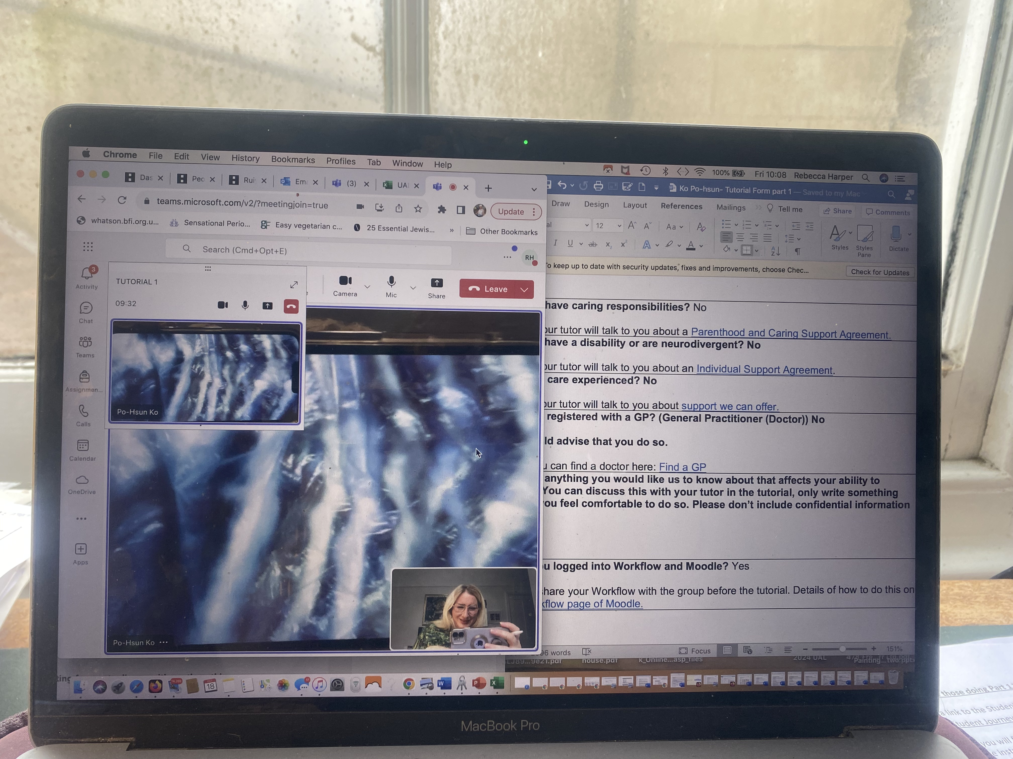
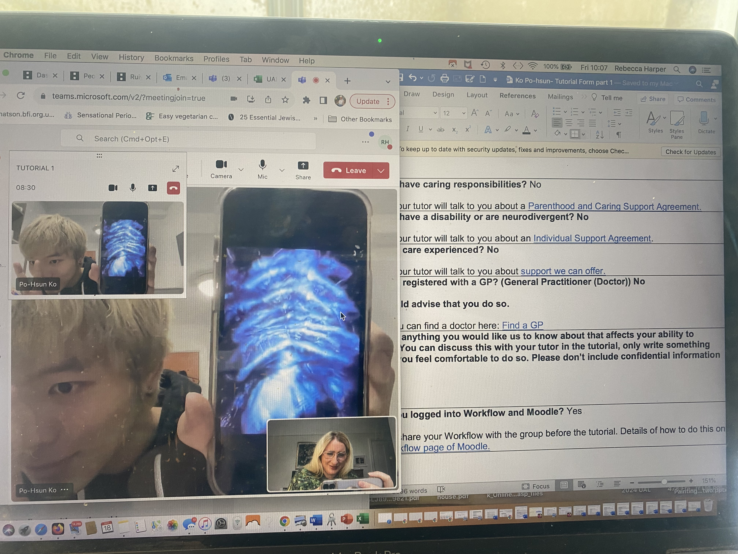
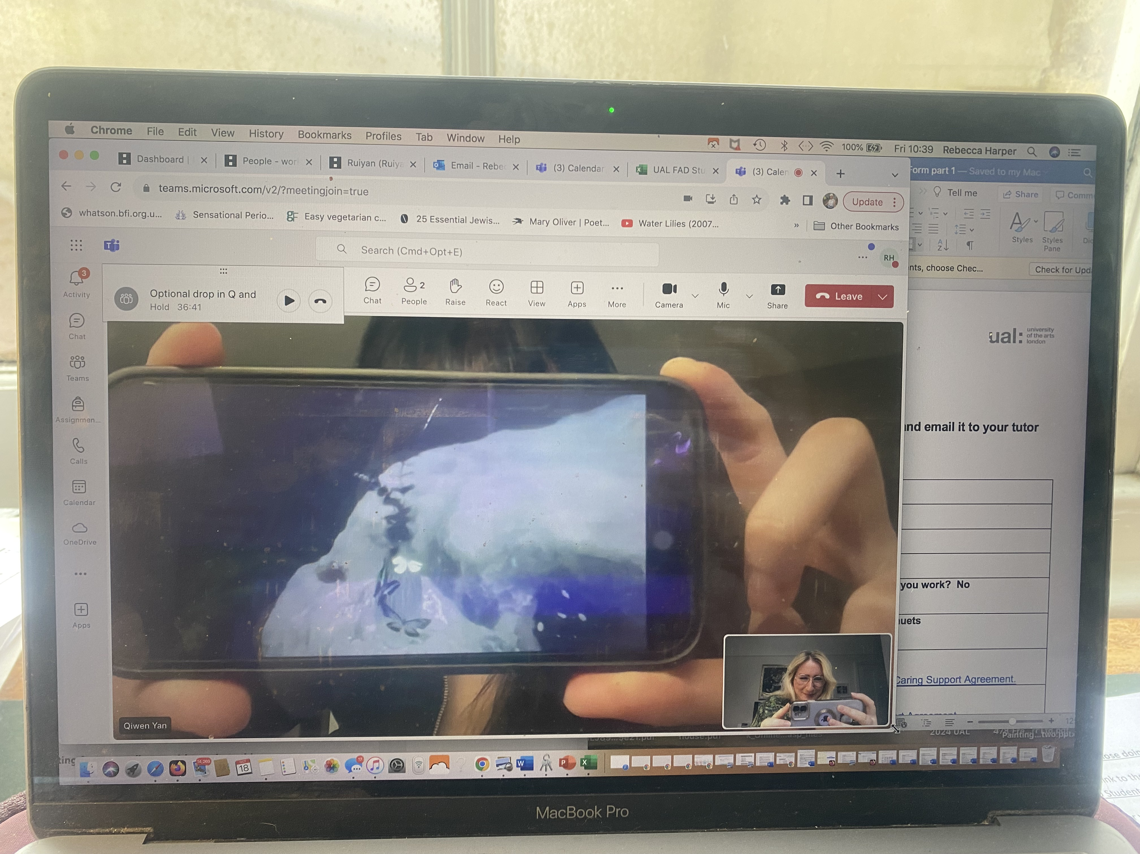
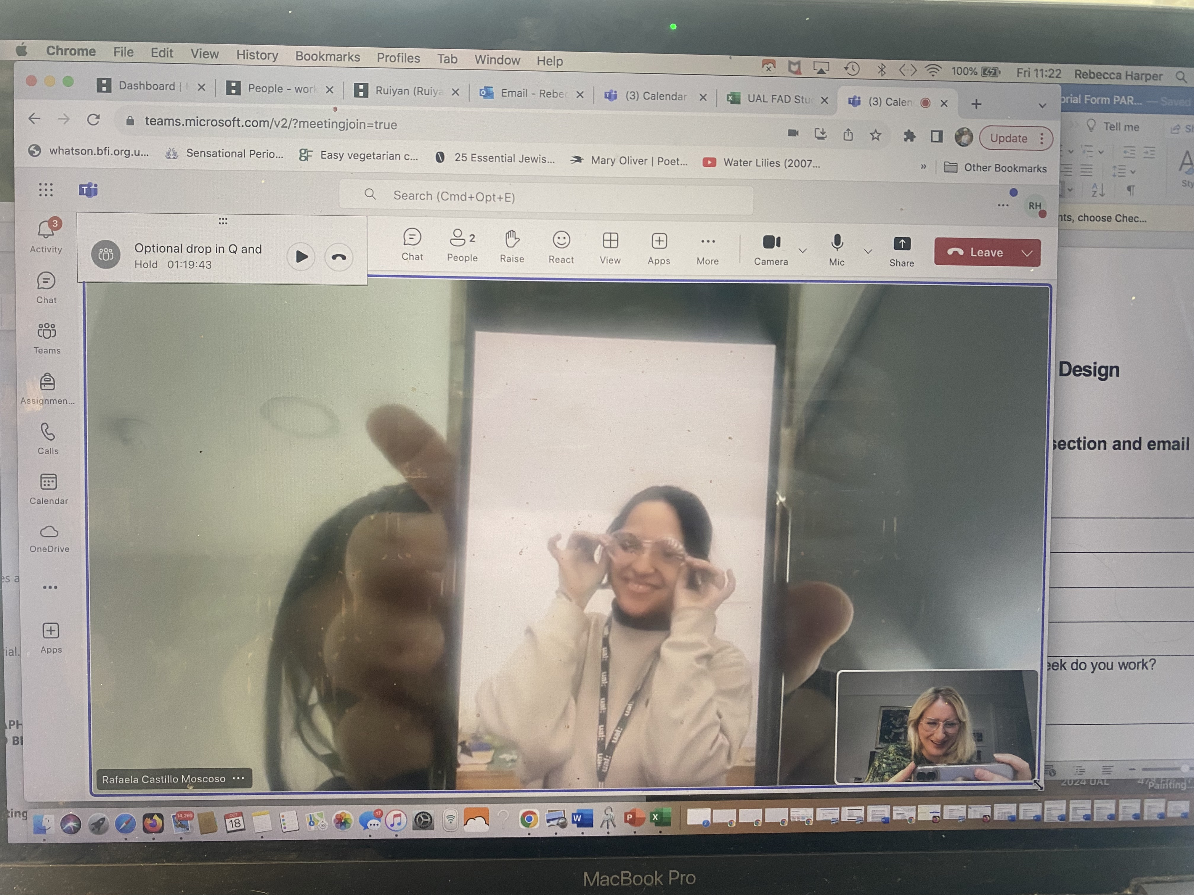
Group 1 - PhotoVoice Method
Students used images to express emotions and thoughts about the course.
Highlights:
- Symbolic visuals sparked personal and collaborative discussions.
- Helped identify individual challenges and aspirations.

Slide 13
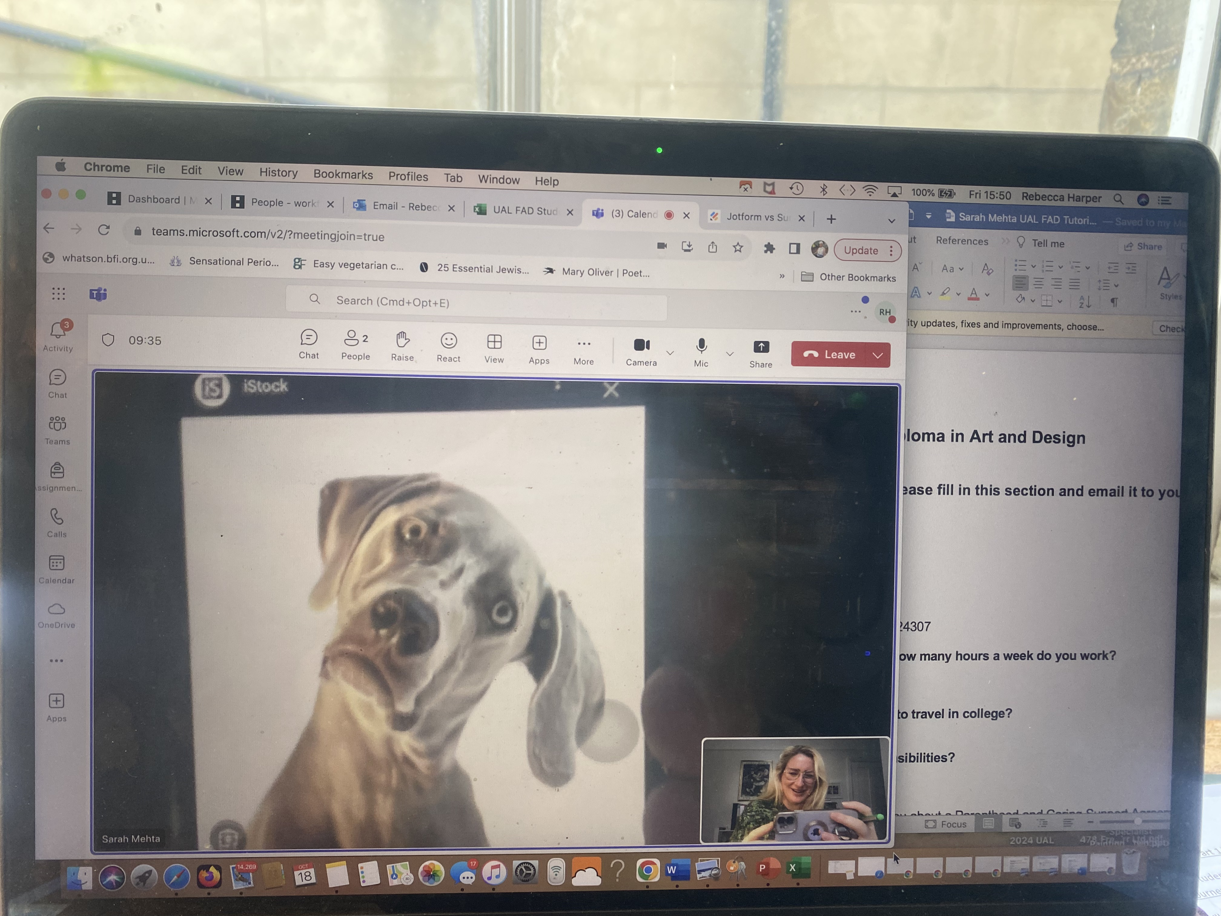
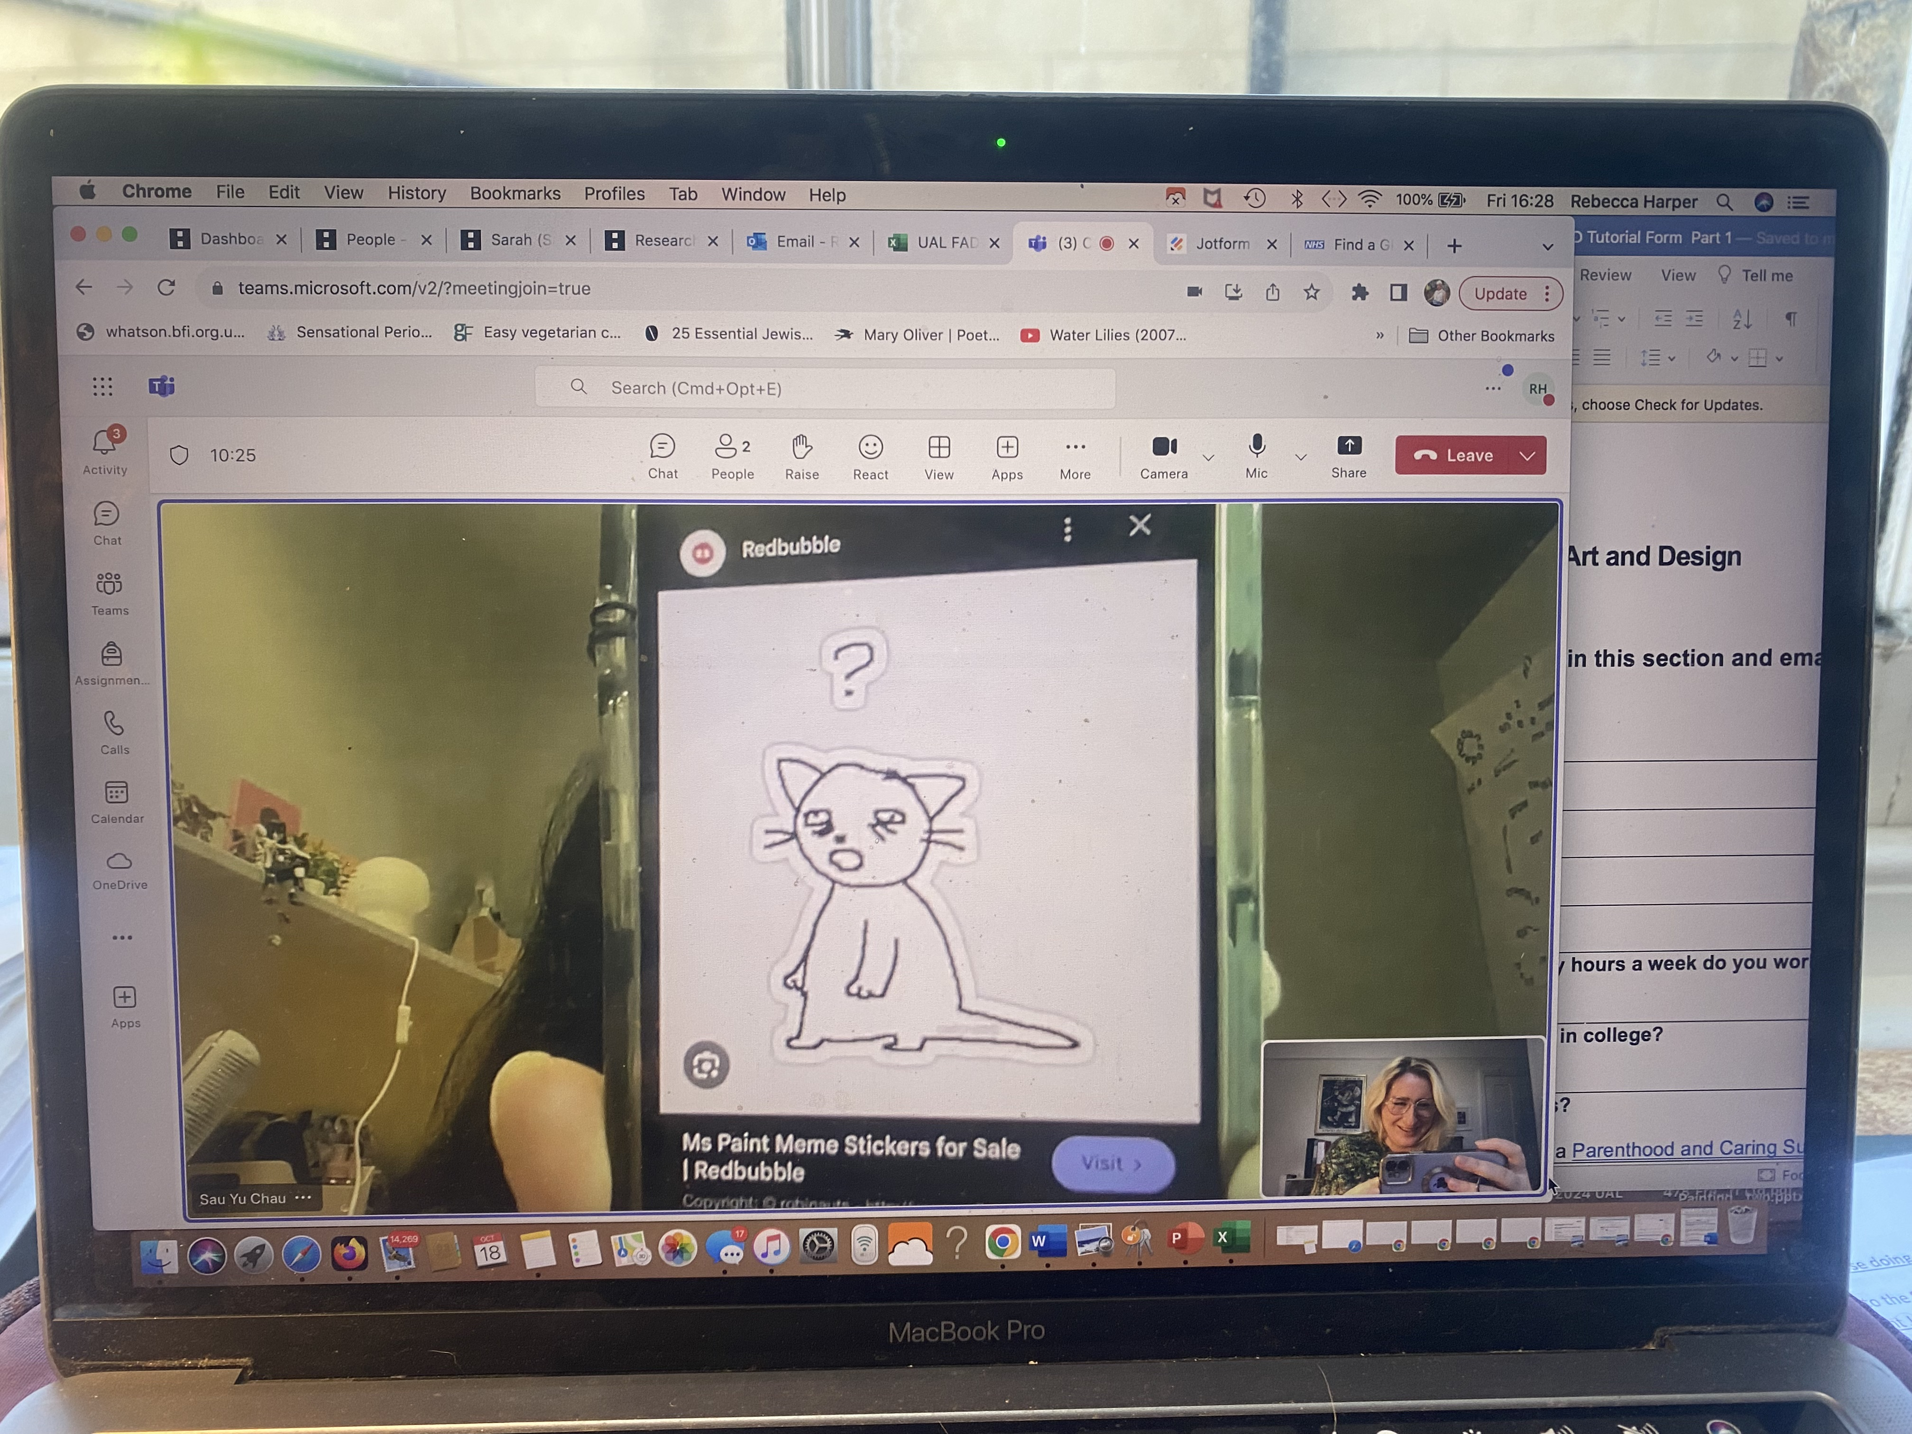
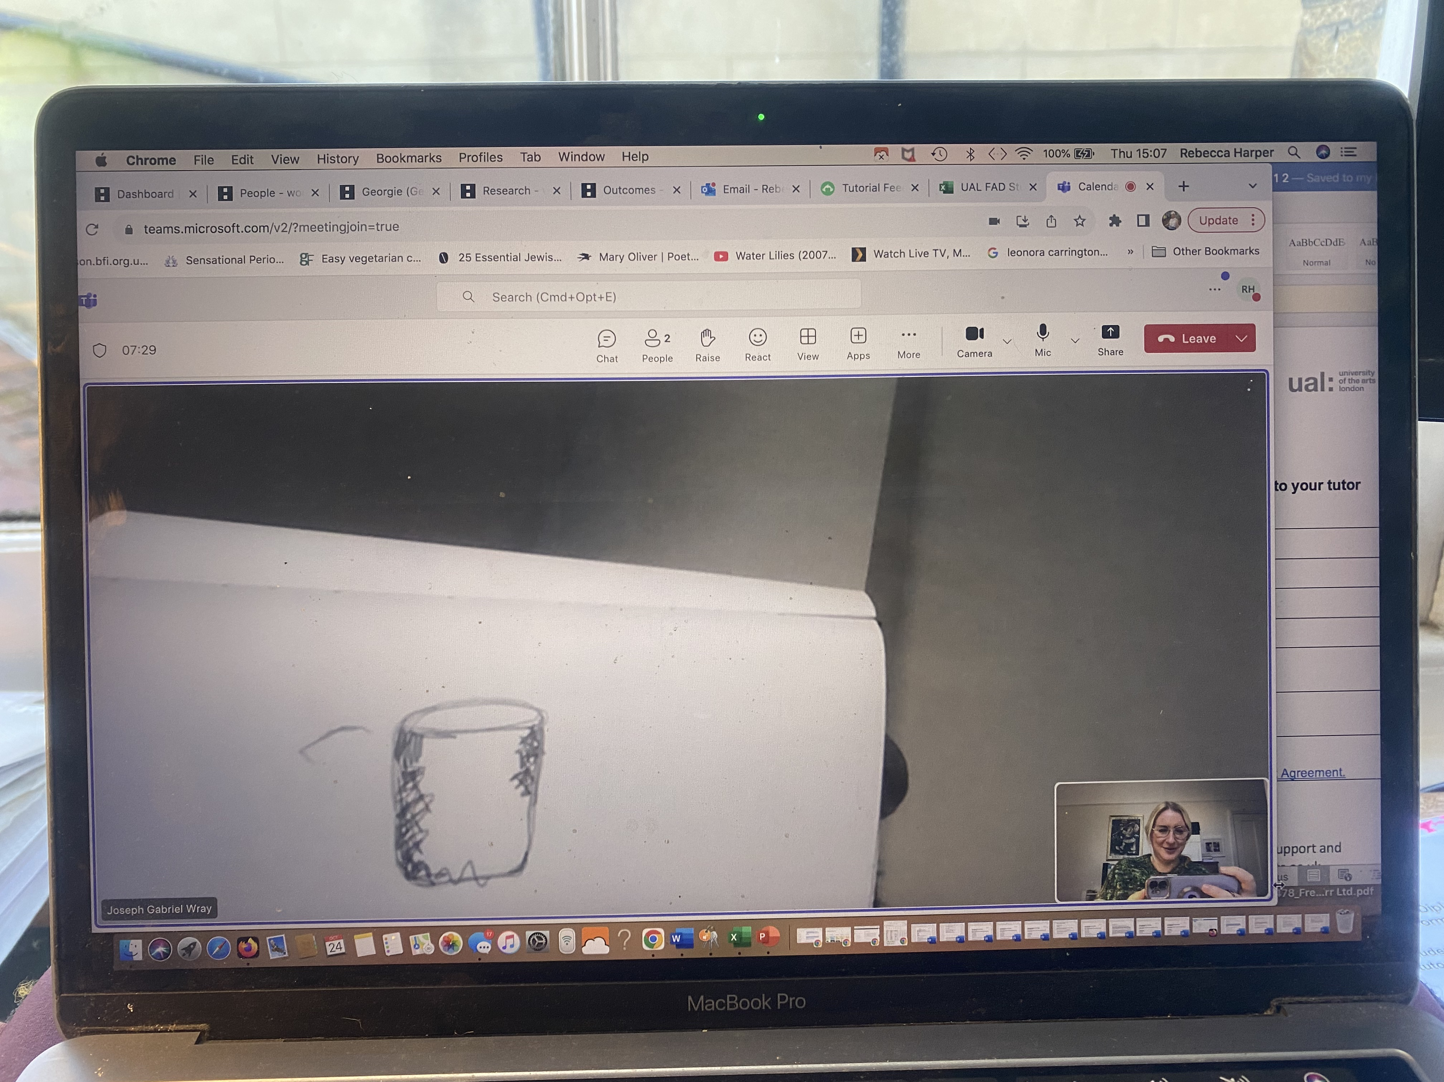
Group 2 - Metaphorical Self-Portrait
Students created symbolic drawings reflecting their artistic identities.
Outcomes:
- Revealed personal stories and cultural contexts.
- Fostered creative self-expression and belonging.

Slide 14
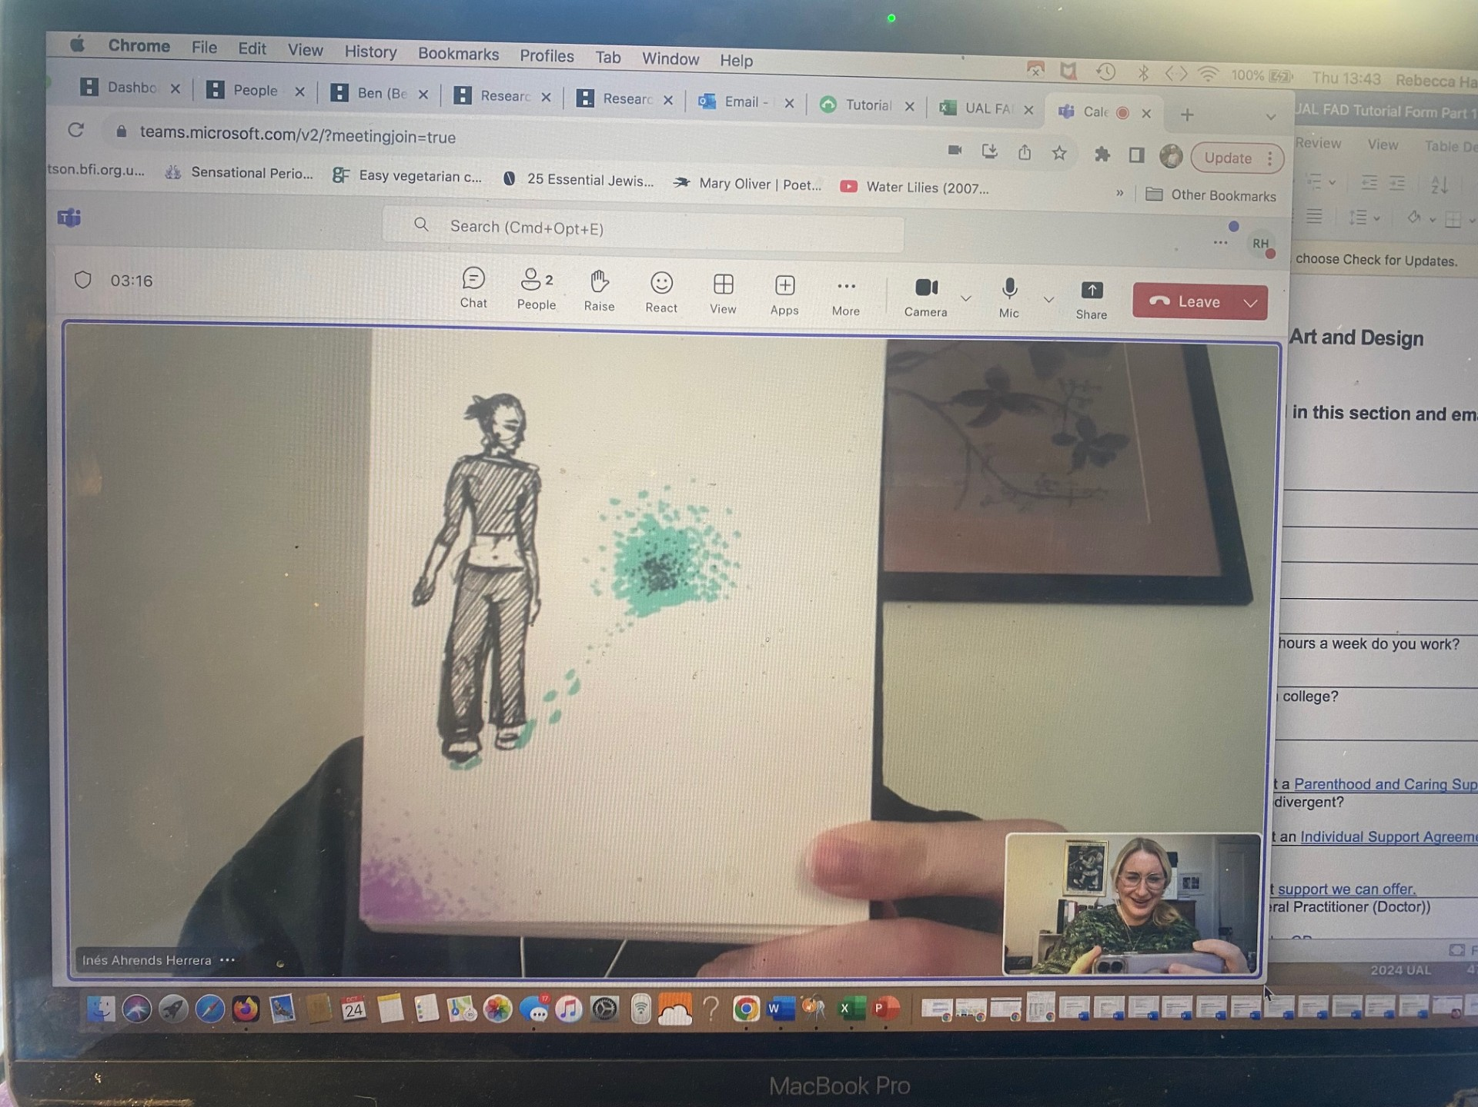
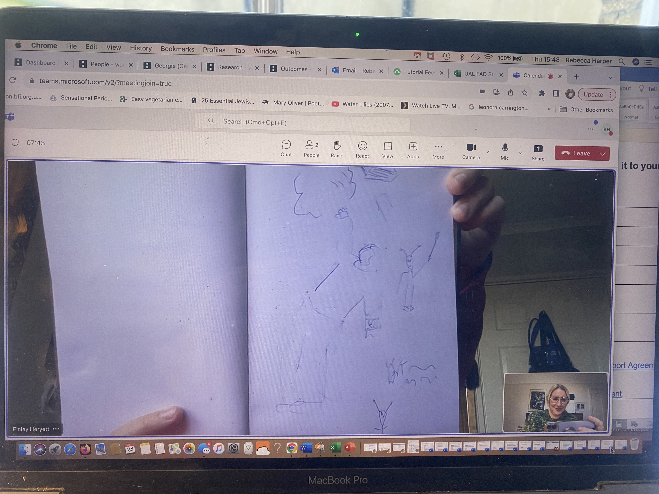
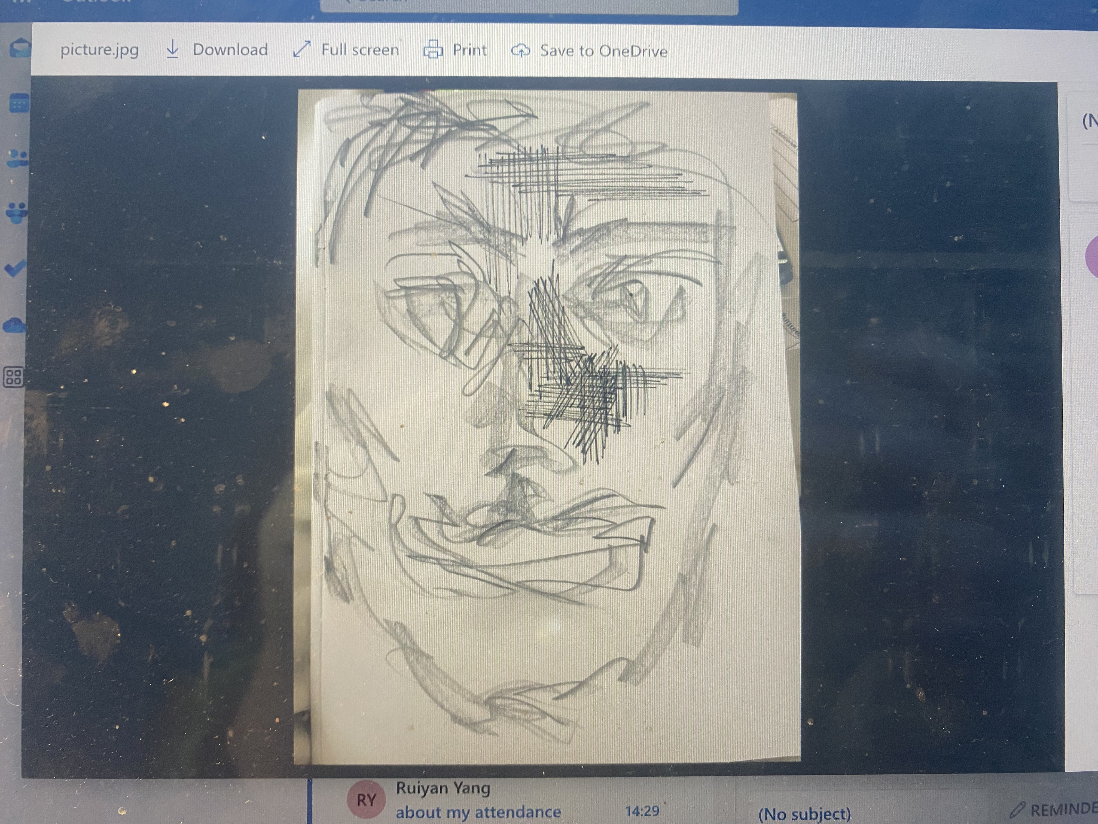
Group 3 - Stuckness Drawing Method
Students visualized creative and emotional blocks.
Findings:
- Opened discussions on overcoming obstacles.
- Showed the value of addressing 'stuckness' collaboratively.

Slide 15
Reflections and Recommendations
Strengths:
• Visual methods fostered trust and engagement.
• Students valued the personal connection and belonging.
Challenges:
• Time constraints.
• Some students needed alternative methods.
Recommendations:
- Tailored icebreakers and extended sessions.
- Further research into group dynamics.

Slide 16
How have I applied those methods?
Using conversational analysis as the preferred research method.
Will formalise my reflections of student observations via catalogued images and highlighted themes derived from transcribed text.
Think authentically about my own bias and credibility of findings.
Victoria Clarke & Virginia Braun (2017) Thematic Analysis. The journey of positive Psychology, pages 12, 3, 297, 295

Slide 17
I then proceeded to post a request for permission for use of images taken of students past and present via verbal conversational means, for my reflective look at my own academic identity/teacher student journey.
The questionnaire was low- moderate uptake but:
What I did receive was valuable and led me to assess the level of engagement with three students.
My findings were:

Slide 18
FEEDBACK • Survey feedback showed appreciation for personal connection and inclusion.
Student quotes

Slide 19
Conclusion
Participatory methods like PhotoVoice can enhance belonging and inclusion.
Practical impact:
- Structured yet flexible tutorials support diverse cohorts.
- Promoting artistic and personal growth through creative engagement.

Slide 20
References
• Jokela, T., & Huhmarniemi, M. (2008). Art-Based Action Research.
• McNiff, J., & Whitehead, J. (2009). Doing and Writing Action Research.
• Wang, C. (1997). Photovoice: Methodology for Participatory Research.

